Slide 1
Hash-Based Indexes
SUN YAT-SEN UNIVERSITY

Slide 2
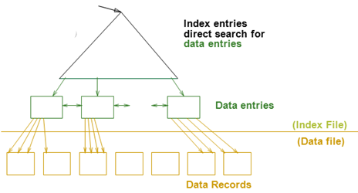
Review
索引技术概述
  可以为关系建立索引，都是文件
  索引文件由两部份组成
    数据项部分
      Data Entry(数据项) data record（数据记录）
    引导部份
      树索引技术
      Hash索引
Cost = log _{F} N (2~3 I/Os)
1~2 I/Os

Slide 3
Introduction
Hash-based indexes are best for equality selections. Cannot support range searches.
Static and dynamic hashing techniques exist; trade-offs similar to ISAM vs. B+ trees.

Slide 4
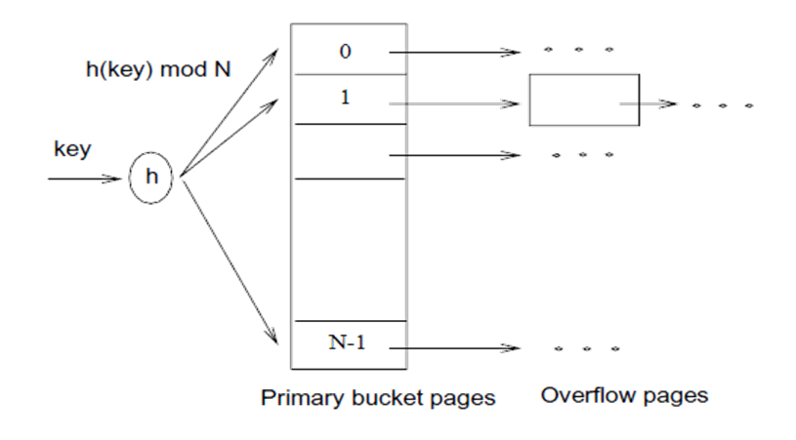
Static Hashing(静态哈希)
索引文件由一系列桶(bucket)组成
  每个桶有一个主页(primary page),也可能有一些溢出页(overflow pages)
静态性
  Number of buckets is fixed
  Primary pages are allocated
  sequentially, never deallocated;
    overflow pages if needed.

Slide 5
Static Hashing (Contd.)
Buckets contain data entries.
定位所属的桶?
  h(k) mod N = bucket to which data entry with key k belongs.
  N = number of buckets
  Hash function(哈希函数) works on search key field of record r. Must distribute values over range 0 ... N-1.
    h(key) = (a * key+ b) usually works well.
    a and b are constants;

Slide 6
Static Hashing (Contd.)
Long overflow chains(长溢出链) can develop and degrade performance.
  Extendible and Linear Hashing: Dynamic techniques to fix this problem.

